Slide 1

Stallion Event
World Leading Application Delivery Controllers

Slide 2

Agenda
A10 Networks Presentation
The Engine: ACOS
AX Series
SLB and ADC Features
IPv6 Features - SLB-PT
IPv6 Features - LSN/CGN
IPv6 Features - DS-Lite
IPv6 Features - NAT64/DNS64

Slide 3



A10 Networks Company Overview
Mission:
The technology leader in Web Application Delivery solutions
Focus:
AX Series: Application Delivery Controller (ADC) Advanced Core OS (ACOS): The platform enabling technology
World class engineering and experienced field teams
Founder/CEO:
Lee Chen - Co-founder of Foundry Networks and Centillion
Headquarters:
San Jose, California
Expanding rapidly:
Cash-flow positive, +850 AX Series customers 15 consecutive growth quarters 157% Growth between 2009 et 2010
2007
2008
2007
2008
2009
© 2010 A10 Networks CONFIDENTIAL
Notes:
3

Slide 4
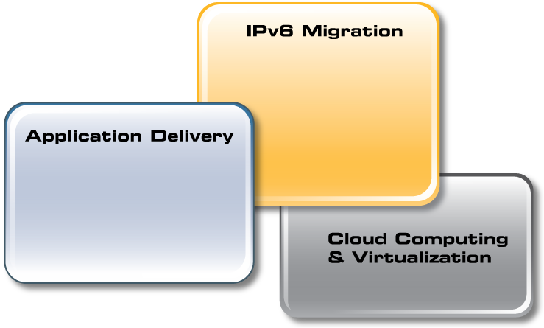
Three Strategic Focus Areas
LSN (Large Scale NAT)
Dual-Stack Lite
SLB-PT
NAT64/DNS64
Improve User Experience
Reduce Infrastructure
Increase Availability
Notes:
Application Delivery
Optimize Application performance and minimise infrastructure whilst delivering the lowest cost per transaction in the industry.
IPv6 Migration
The only Edge solution with a complete suite of SW features to allow Carriers and Service Providers to migrate seamlessly whilst maximizing service availability and differentiating their business.
Allows the Enterprise to be in charge of their destiny and maximise client reach whilst avoiding being at the mercy of the carrier.
Virtualization
A suite of 4 solutions to fit any Data Centre Consolidation, Cloud or Hosting scenario whilst maximizing utilization and return from the solution.

Slide 5



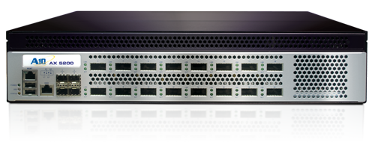
Single Solution, Differentiated Value
Application Delivery
IPv6 Transition
Cloud Computing & Virtualization
Improve User Experience
Reduce Infrastructure
Increase Availability
LSN (Large Scale NAT)
Dual-Stack Lite
SLB-PT
NAT64/DNS64
L2/L3 Virtualization
Soft-AX
AX-V
Virtual Chassis

Slide 6















































AX Series Sample Customers
Florence County

Slide 7
The Engine: ACOS

Slide 8


ACOS
Highly Efficient Advanced Core Operating System (ACOS)
  64 bit
  Memory, processing & I/O efficiency
  More user connections per unit
  Faster application access
Best Combination of Software and Hardware
  Hardware off-load and acceleration
  Less Servers, Rack Space, Power, Cooling, Server Licenses
  Reduced Operating Costs
Scalable Symmetrical Multi-Processing (SSMP)
  Highest industry performance
  Maximum headroom for growth

Slide 9
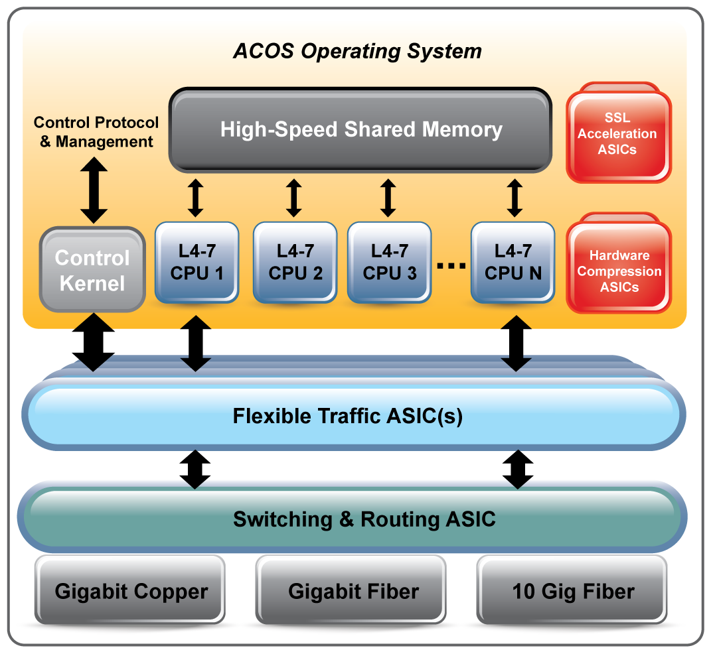
Superior System Design & Architecture
SSL Acceleration Module – SSL Processing
Application Memory – Session Tables, Buffer Memory, Application Data
L4-7 CPUs – L4-7 Processing, Security
Control Kernel – CLI, GUI, Management Tasks and Health Checking
Flexible Traffic ASIC (FTA) –
Distributes Traffic Across L4-7 CPUs, Efficient Network I/O, DDoS
Switching & Routing ASIC –
L2 & L3 Processing and Security
Notes:
9
9
9
9

Slide 10
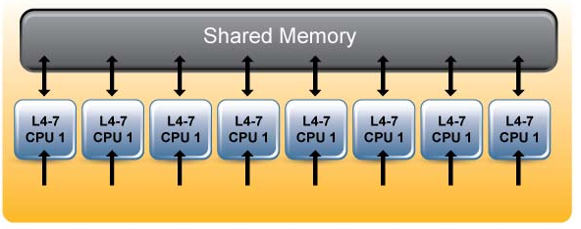
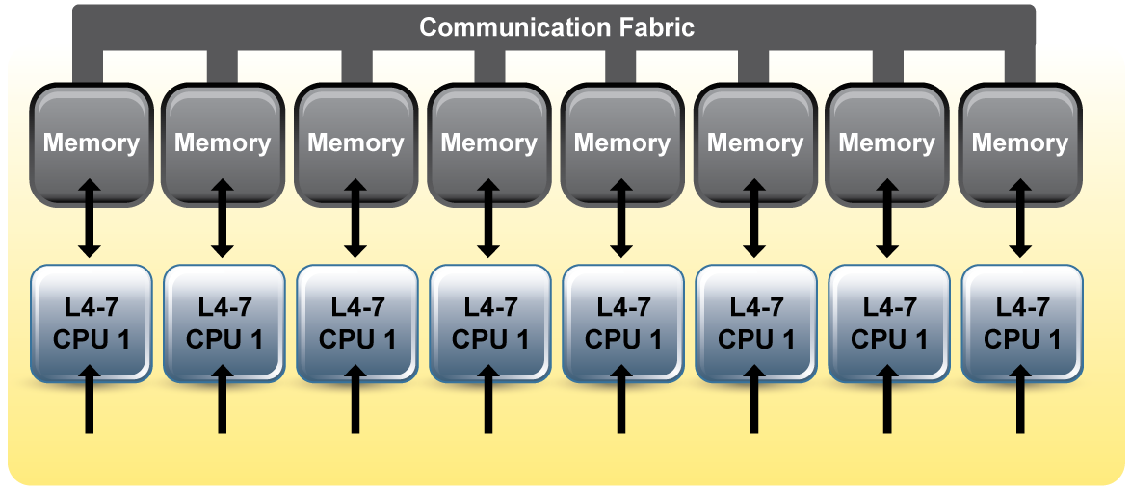
Superior System Design & Architecture
AX Series Shared Memory
Replicate to each core’s dedicated memory
All other platforms today
Notes:
10
10
10

Slide 11
AX Series

Slide 12










AX Series Appliances
AX 1000
Throughput: 4 Gb
AX 3200
Throughput: 8.7 Gb
AX 2200
Throughput: 7.4 Gb
AX 2500
Throughput: 10 Gb
AX 3000-GC
Throughput: 24 Gb
AX 5100
Throughput: 40 Gb
AX 5200
Throughput: 40 Gb
AX 2600-GC
Throughput: 18 Gb

Slide 13





AX Series Enterprise Class Performance Chart
 | AX 1000 | AX 2500 | AX 2600 | AX 3000
Application Throughput | 4 Gb | 10 Gb | 18 Gb | 22 Gb
Layer 4 CPS | 153,000 | 300,000 | 355,000 | 440,000
Layer 7 RPS (unlimited CR) | 275,000 | 700,000 | 740,000 | 800,000
DDoS Protection (SYN Flood) SYN/Sec | 1 million | 2.1 million | 2.3 million | 2.6 million
SSL CPS | 5,500 | 7,900 | 11,000 | 11,000
SSL TPS (10 transactions/conn) | 18,000 | 57,000 | 85,000 | 85,000
SSL Bulk Throughput | 1.2 Gb | 1.2 Gb | 2 Gb | 2 Gb
Notes:
Unlimited CR = Unlimited Connection Reuse

Slide 14
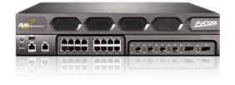

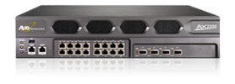
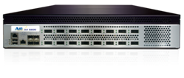
AX Series Carrier Class Performance Chart
 | AX 2200 | AX 3200 | AX 5100 | AX 5200
Application Throughput | 7.4 Gb | 8.7 Gb | 40 Gb | 40 Gb
Layer 4 CPS | 302,000 | 541,000 | 2,000,000 | 3,020,000
Layer 7 RPS (unlimited CR) | 750,000 | 1,507,000 | 1,400,000 | 3,200,000
DDoS Protection (SYN Flood) SYN/Sec | 5.6 million* | 9.24 million* | 50 million* | 50 million*
SSL CPS | 16,000 | 29,000 | Option | Option
SSL TPS (10 transactions/conn) | 45,000 | 90,000 | Option | Option
SSL Bulk Throughput | 1.3 Gb | 2 Gb | Option | Option
* 0% CPU utilization
Notes:
Unlimited CR = Unlimited Connection Reuse

Slide 15
Management

Slide 16
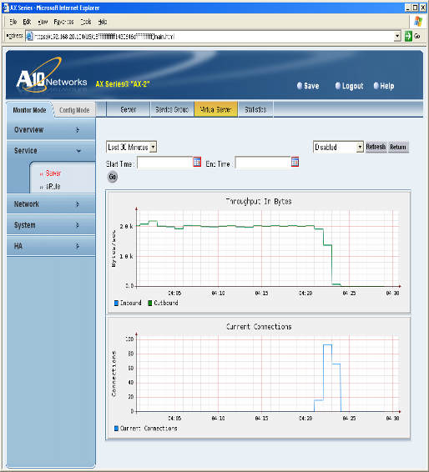
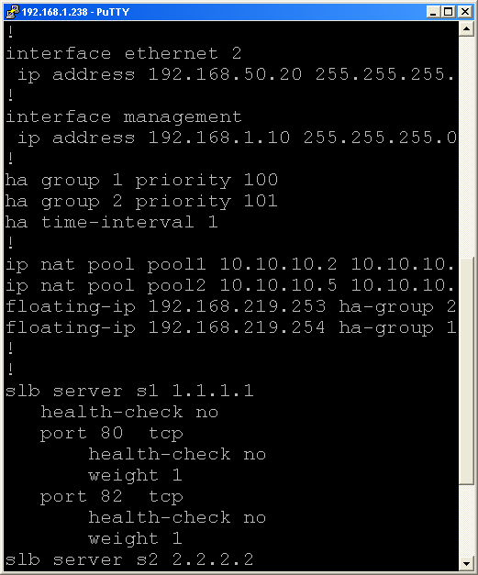
Manageability
Flexible Configuration
  Cisco Like CLI
  Simple to use GUI
Powerful External Healthchecks
  Python, Perl, TCL, Bash
  Multi Layer
aFleX
  TCL based Application Control
aXAPI
  REST Format
  Quicker implementation than SOAP
    Less code
    Less complex
    Easier to understand/support
Notes:
16

Slide 17
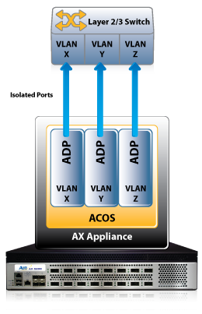
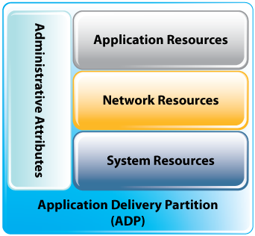
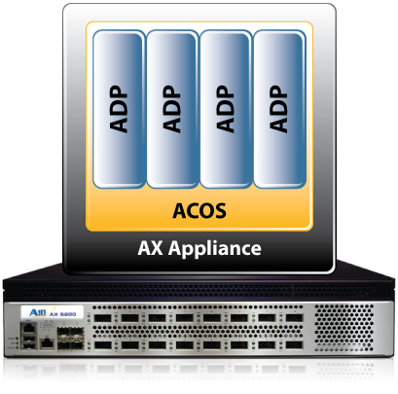
Virtualization:
Layer 2/3 Virtualization Solution for AX Virtualization
Expanded capability within Application Delivery Partitions (ADPs) for 64-bit platforms
Granular Layer 2/3 network virtualization per ADP
  Completely separate from those in other partitions, each ADP (up to 128) has has its own:
    MAC table and ARP table
    IPv4 and IPv6 route tables
  Layer 2 Virtual resources
    VLANs, Ethernet (VE) interfaces & Static MAC entries
  Layer 3 resources
    IP addresses, ARP entries & Routing tables
Notes:
AX Virtualization ADPs (Application Delivery Partitions) now allow distinct L2/3 configurations per partition
Up to 128 separate L2/3 configurations (varies by model)
Supports IPv4 or IPv6 today

Slide 18
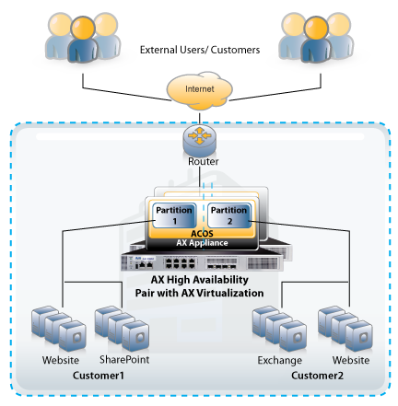
Virtualization:
Layer 2/3 Virtualization Benefits for AX Virtualization
High performance multi-tenancy between applications & organizations
  No virtualization (hypervisor) performance penalty
Reduces the number of Application Delivery Controllers required
  Cost-effective production quality multi-tenancy
Eases transition to multi-tenant configurations
  Management complexity
Integrated natively to ACOS, no 3rd party software/licenses

Slide 19

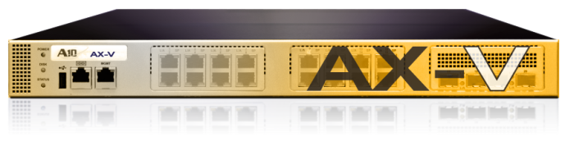
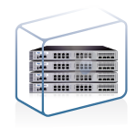

AX Series Virtualization Products
SoftAX
  AX virtual machine (VM) on commodity hardware
AX-V Appliance
  Powers multiple AX virtual machines
AX Virtual Chassis
  Scale multiple AX devices

Slide 20
SLB and ADC Features

Slide 21
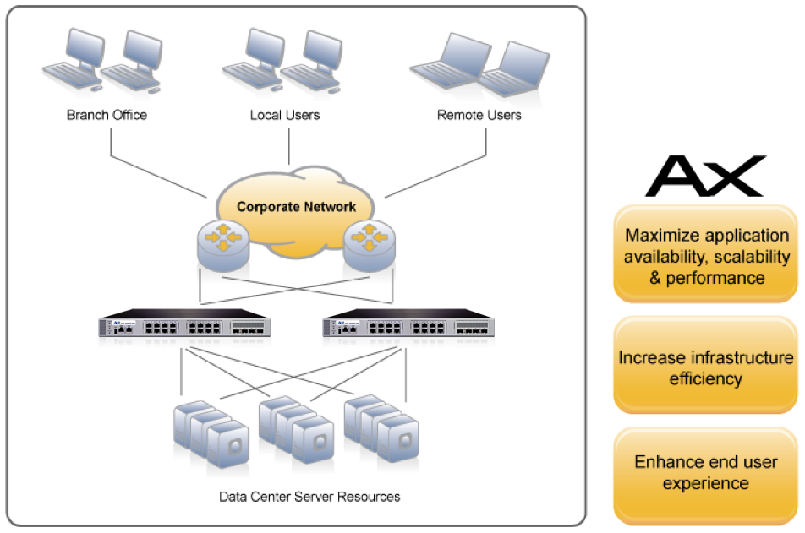
The AX Series Solution
Load Balance any IP protocol
  For availability
  For scalability
  For performance
Accelerate servers by off-loading computationally intensive functions
  Faster end user experience
  Reduce number of servers

Slide 22
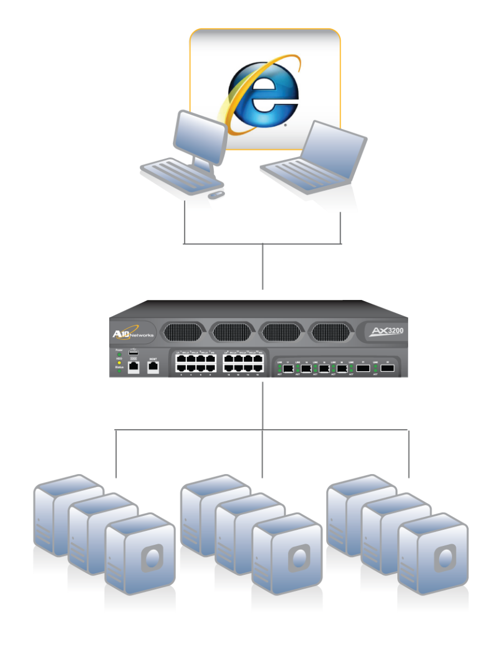
Server Load Balancing
Monitor Server Health
  TCP Level Health Checks
  Application Layer Health Checks
  HTTP and HTTPS
  Scriptable Health Checks
  External Health Checks
Load Balancing
  Round Robin
  Least Connections
  Fastest Response
  Weighted
  Priority
Session Persistence
  Source IP
  Cookie-based
  SSL Session ID
  URL
AX Redundancy
  Active/active or Active/passive

Slide 23
GSLB – Global Server Load Balancing a.k.a. Intelligent DNS
  DNS Proxy
    This method is the most commonly used global server load balancing as it does not disrupt customers’ existing name resolution
  Disaster recovery
    Provide extra level of High availability to important applications
  RTT
    Send client connections to the fastest responding datacenter
  Session capacity
    Send client connection to the datacenter with the most available capacity
  Weighted values
    Send client connections to the datacenter with the highest combined score
  Most active servers
    Send client connections to the datacenter with the most available active servers
  Geo-location
    Send client connection to the “closest” datacenter
Disaster Recovery
Multi-Site Load Balancing
Notes:
23

Slide 24
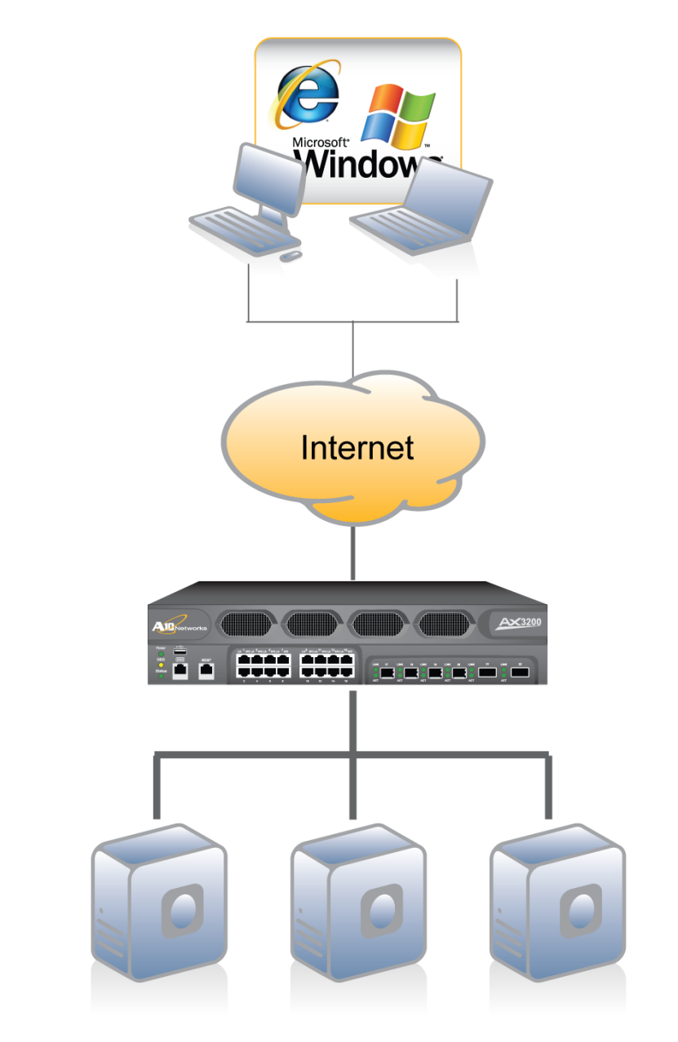
Optimize Your Application Delivery
TCP Optimization
Compression
Static and Dynamic Caching
SSL Acceleration and termination
Source IP Req Rate Limiting
DNS RAM Caching
DNSSEC Support
aFleX Rules

Slide 25
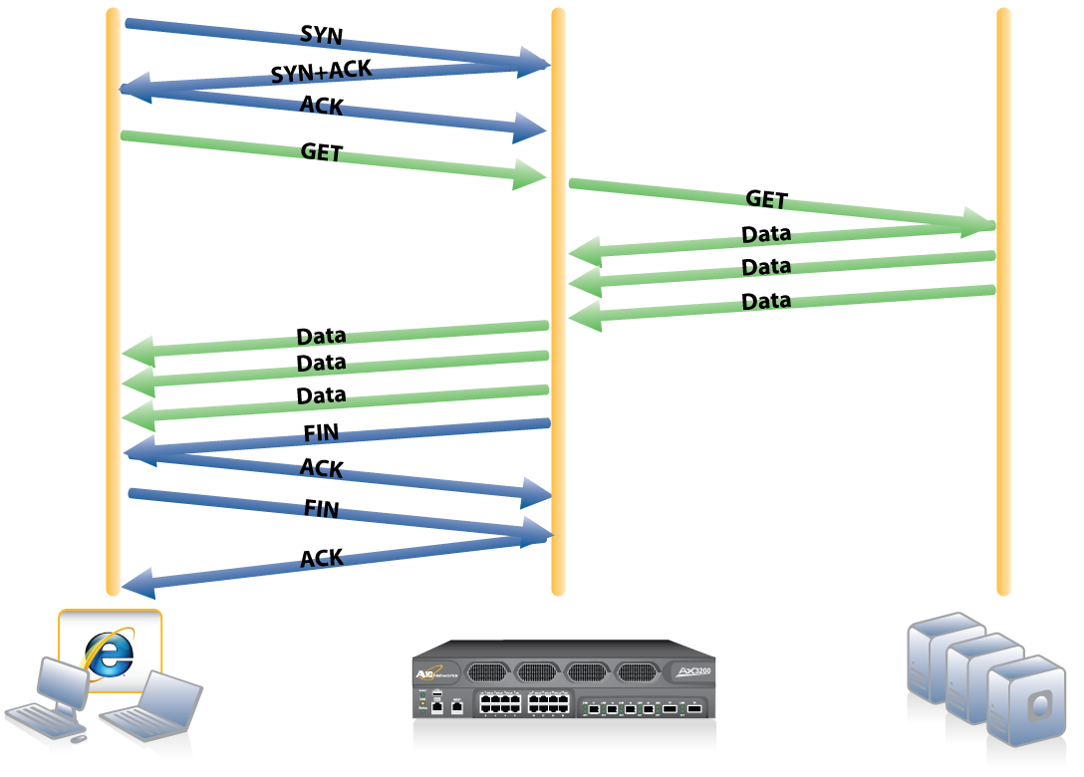
TCP Offload

Slide 26
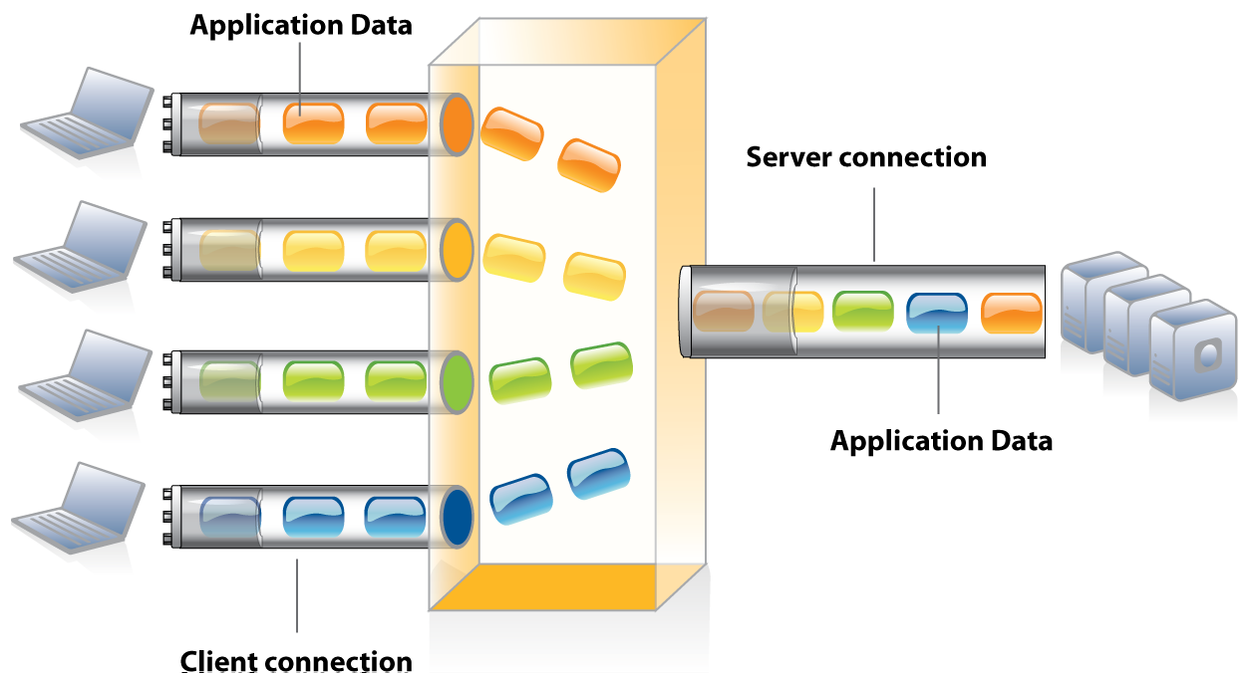
TCP Connection Reuse

Slide 27
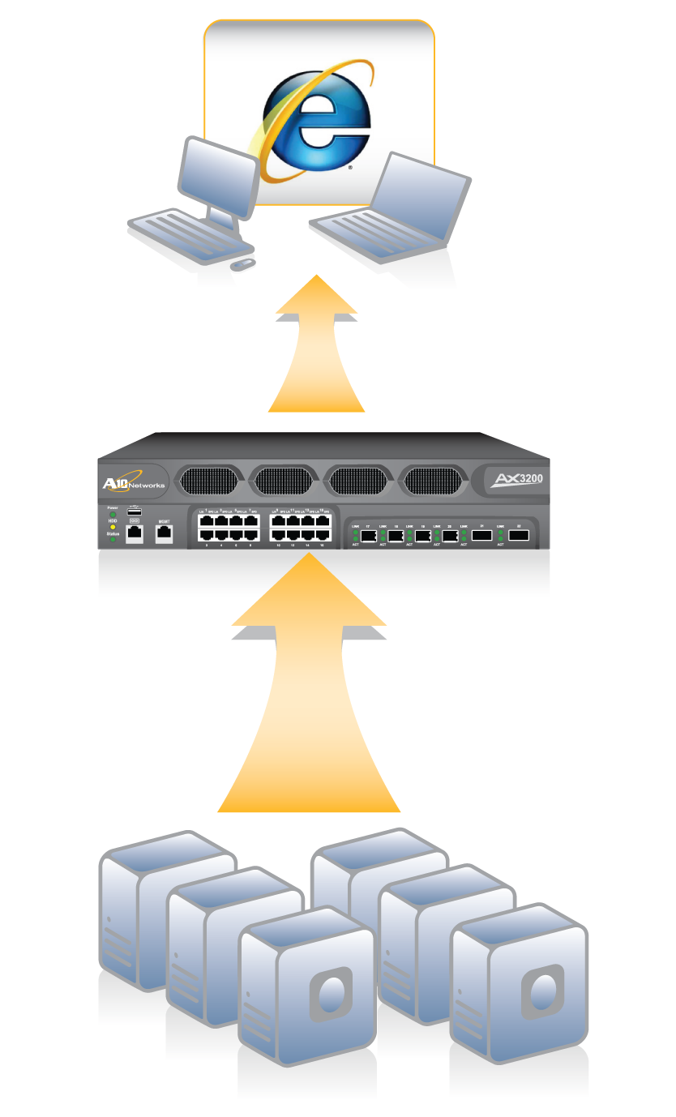
Compression
HTTP & HTTPS
Compatible with all modern day web browsers
Reduce the amount of data and packets being sent to the client
Offload compression from the servers
Improve client access performance over the WAN

Slide 28
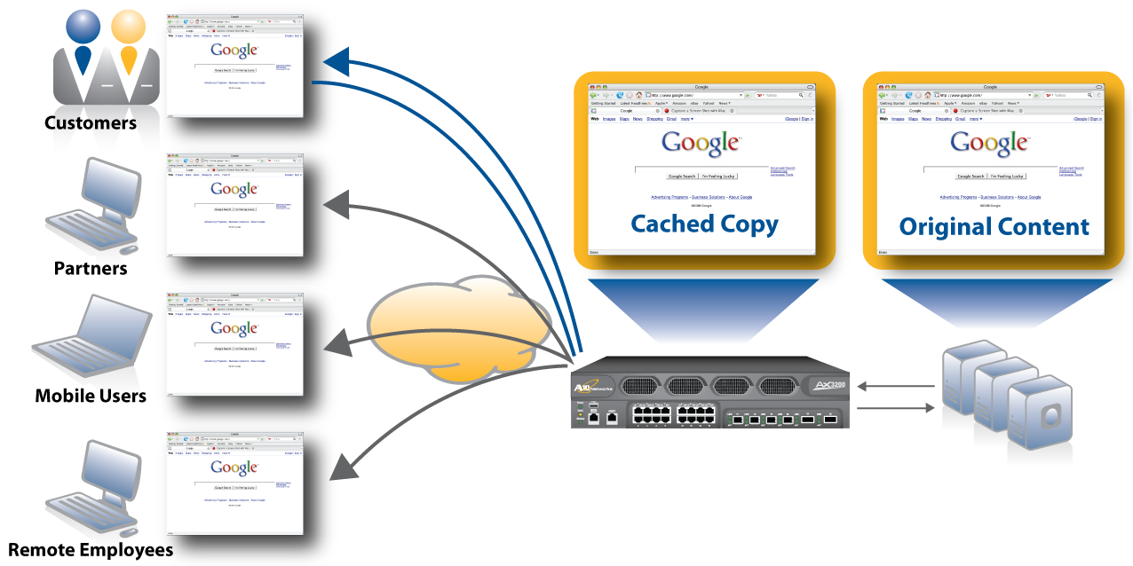
Static and Dynamic Caching
Additional Request
Initial Request

Slide 29
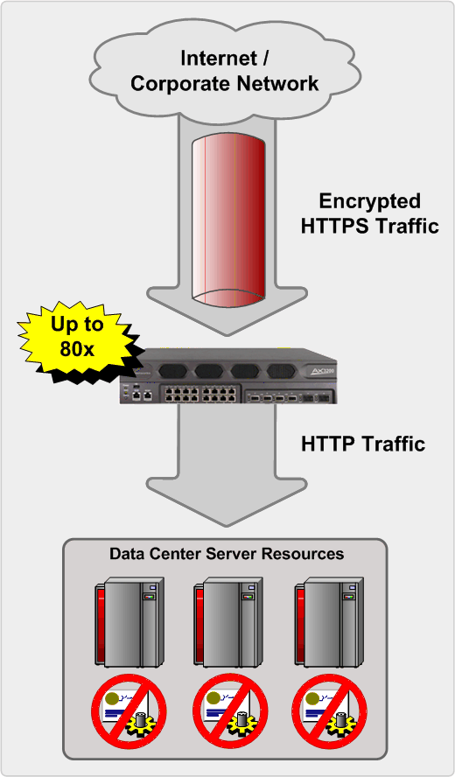
High Performance SSL Acceleration
  Hardware based SSL Processing
    Eliminate CPU intensive server-based SSL
    Recover server resources
    Improve server capacity
  Central Certificate Management
    Eliminate need for server certificates
    Simplify certificate management
Notes:
29

Slide 30
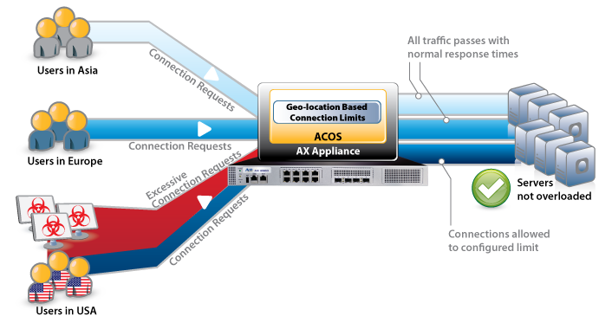
Dynamic Traffic Management and Protection:
Geo-location Based Connection Limiting per VIP
Solution
  Connection Limits based on geographic location lists
  Mitigate DDoS attacks from specific countries or regions automatically
Benefit
  Regional traffic flows unhindered.
  Prioritize traffic from specific regions

Slide 31


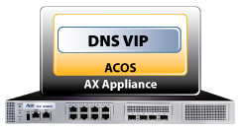



Dynamic Traffic Management and Protection:
Selective DNS Caching
Solution allows per VIP caching
  Granular DNS caching polices, e.g. on a per domain basis
  Selective caching based on pre-configured limits & query criteria
  Transparent to the user
  Previously on a global basis only
Benefits:
  DNS server off-load
  Automatic addition of performance as needed
  Users have uninterrupted DNS availability
  Responsive during unexpected traffic conditions or attacks

Slide 32
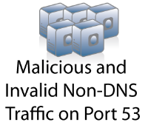


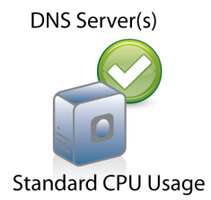







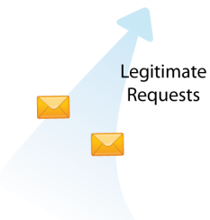



Innovation: DNS Application Firewall
Reduce load and servers up to 70%
For Large DNS Infrastructures
  Legitimate DNS protocol traffic only, surge protection and increased capacity
  Increased security for backend servers
        Quarantine malicious traffic for inspection and mitigate DDoS attacks

Slide 33
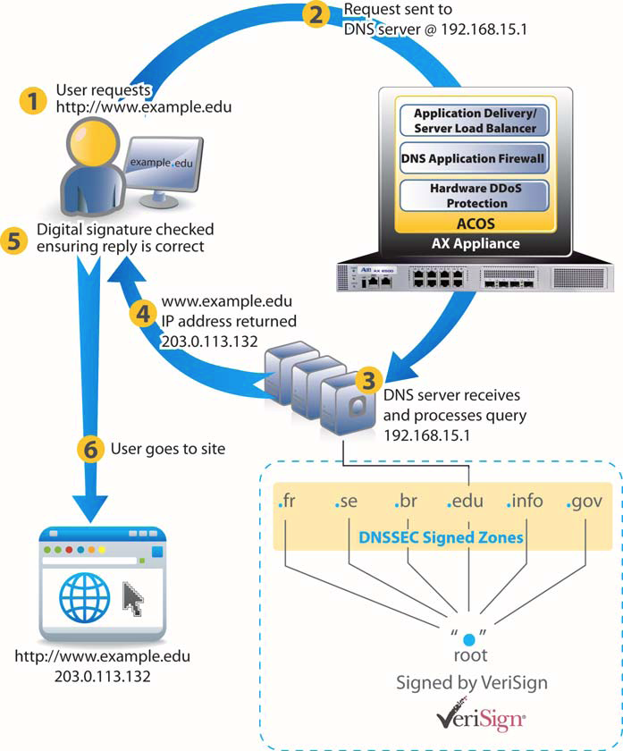
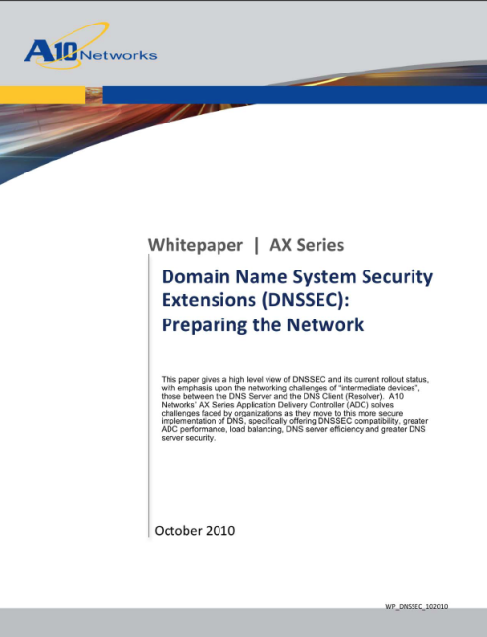

DNSSEC Support Compatibility Benefits
High Performance solution to minimize increased DNSSEC overhead
No interruption of service transitioning to DNSSEC
Validated by VeriSign

Slide 34
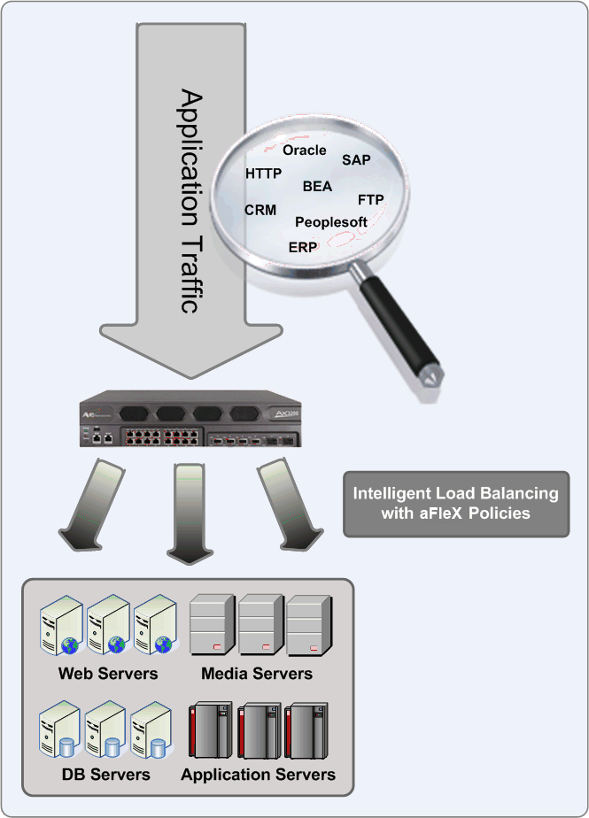
Flexibility
aFleX - ADVANCED SCRIPTING
Inspect all application traffic types beyond traditional Layer 4-7
Looks into application traffic flow to identify decision criteria
Switch, drop, or redirect based on aFleX policies
aFlex development environment simplifies policy creation and maintenance

Slide 35
IPv6 Features

Slide 36
Classic NAT for Server Load Balancing
Network Address Translation (NAT) is critical feature for server load balancing
The AX offers multiple types of NAT
  Destination NAT (half-NAT): Dst IP changed from VIP to real server IP
  Source NAT (full-NAT): Both Src IP and Dst IP are changed so traffic comes back to AX
  Reverse NAT: Translates real server’s private IP to public IP allowing real server to initiate session to clients
  Direct Server Return (DSR): Only the destination MAC is NAT’ed, the DST IP is still the VIP

Slide 37
Advanced NAT: Carrier IPv6 Transition Solution
Traditional NAT/NAPT
  IPv4-IPv4 with ALGs for FTP, RTSP, MMS, SIP
SLB-PT
  IPv6 VIP -> IPv4 Servers
  IPv4 VIP -> IPv6 Servers
  Combination modes
Large Scale NAT (LSN) - also known as Carrier-Grade NAT (CGN)
  IPv4-IPv4
Dual-stack lite NAT
  Large Scale NAT + IPv6
NAT-PT/NAT64
  IPv4-IPv6, IPv6-IPv4

Slide 38
SLB-PT/SLB-IPv6

Slide 39
SLB-PT (SLB - with Protocol Translation)
Same high performance SLB, but with address family translation
Facilitates transition to IPv6
  Enterprises
  Content Providers
Various modes
  IPv4 VIP -> IPv6 Real Servers
  IPv6 VIP -> IPv4 Real Servers
  IPv4 VIP -> Combination of IPv4 and IPv6 Real Servers
  IPv6 VIP -> Combination of IPv6 and IPv4 Real Servers

Slide 40




SLB-PT – Topology
IPv4 Content
(IPv4 Servers)
AX SLB-PT
IPv6 VIP
IPv4 Internet
IPv6 Internet
IPv4 Clients
IPv6 Clients

Slide 41

SLB-PT – Full Topology
IPv4 and IPv6 Servers
AX SLB-PT
IPv4 VIP
AX SLB-PT
IPv6 VIP
IPv4 Internet
IPv6 Internet
IPv6 Clients
IPv4 Clients

Slide 42
LSN / CGN

Slide 43
Large Scale NAT (LSN/CGN)
Solutions ?
  IPv6 = Long term solution
    Adoption underway but still a long way to go
    IPv4-only nodes and content will still be around
  Large Scale NAT = Proposed (Interim) Solution
    Also known as Carrier-Grade NAT
What is Large Scale NAT ?
  Sharing of “Public” IPv4 addresses among multiple customers

Slide 44

Large Scale NAT Topology (NAT444)
Two Layer of NAT
  Customer Premise Equipment NAT (Proprietary NAT)
  Service Provider NAT (LSN)
Public IPv4 Internet
Large Scale NAT
Provider Private IPv4 Network
CPE NAT
CPE NAT
Consumer Private IPv4

Slide 45

Large Scale NAT Topology (NAT44)
Single Layer of NAT
  Provider assigned end devices
  Ideal for mobile handsets
Public IPv4 Internet
Large Scale NAT
Provider Private IPv4 Network

Slide 46
Traditional NAT issues
Needs ALG’s in some cases for applications which embed information in the packet (e.g DNS, FTP, SIP, MMS, RTSP, etc)
Encryption can hide information required for correct Nat operation
All forward and reverse traffic needs go through the same device.
Logging of translations for auditing purposes.
  Needs to be well thought out to cope with traffic volumes

Slide 47
Solution: Large Scale NAT (LSN/CGN)
Requirements for an ISP NAT device ?
  Highly transparent
    so that existing user applications continue to work
    Minimal to no impact on customers
  Well defined NAT behavior
    so that new user applications can easily be developed
    Consistent
    Deterministic
  Fairness in resource sharing
    User guarantees and protection
  Works for both client-server (traditional) and client-client (P2P) applications

Slide 48
Large Scale NAT (LSN/CGN)
Based on the following IETF RFCs and Drafts
  BEHAVE-TCP (RFC 5382)
  BEHAVE-UDP (RFC 4787)
  BEHAVE-ICMP (draft-ietf-behave-nat-icmp-09)
  CGN (draft-nishitani-cgn-00)
LSN Advanced NAT Features
  Sticky Internal IP to External IP mapping
  Full Cone NAT
  Hair-pinning support
  Fairness in sharing the resources – User Quotas
  Tolerance for various kinds of traffic patterns and protocol behavior
As a requirement for Carriers, LSN is the NAT engine embedded in all the IPv6 transition protocols

Slide 49
LSN features – AX LSN scalability
 | # LSN sessions | # New LSN sessions/sec | LSN pool IPs | LSN Throughput
AX5200 | 128 M | 1.5 M | 10K (default 2k)¹ | 40Gbps
AX5100 | 128 M | 1.0 M | 10K (default 2k)¹ | 40Gbps
AX3000 | 64 M | 175 K | 4K (default 500)¹ | 22Gbps
AX2600 | 32 M | 145 K | 2K (default 500)¹ | 18Gbps
AX2500 | 32 M | 125 K | 2K (default 500)¹ | 10Gbps
  LSN pools/groups
    All AX platforms: 500 LSN pools (list of public IP@)
      200 LSN groups (group of individual LSN pools)
        Each LSN group can have up to 25 individual pools
Notes:
1: To change the maximum LSN public IP:
CLI: AX(config)# system resource-usage nat-pool-addr-count <num>
To see the maximum LSN public IP configuration:
CLI: AX# show system resource-usage

Slide 50
Large Scale NAT (LSN/CGN)
Advantage – Helps ISPs continue growing their business by temporarily alleviating the IPv4 address shortage issue
Disadvantages/Considerations –
  Double NAT – Two layers of NAT
    NAT in the ISP network
    NAT in the customer premises
  Addressing issues
    Private address conflict on NAT in customer premise
      Subnets on ISP and customer side need to be different
    Limited number of RFC 1918 addresses
  Does not provide a transition path to IPv6
Proposed Alternative: Dual-Stack Lite (DSLite)

Slide 51
DS-Lite

Slide 52
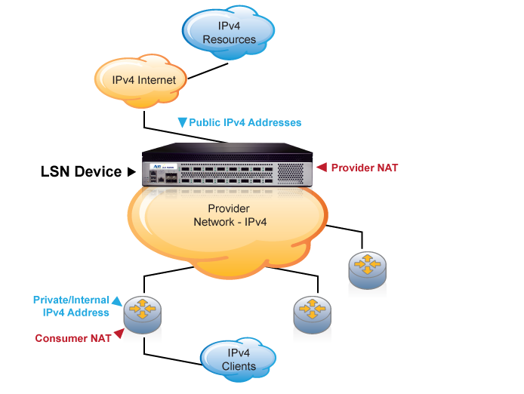
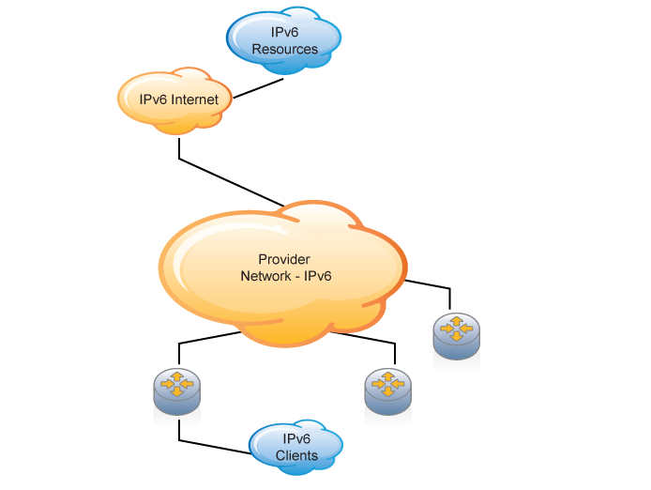
But LSN alone is just a solution to wait, not a real transition step
Two separate options/networks

Slide 53
Dual-Stack Lite (DSLite)
IETF Draft - draft-ietf-softwire-dual-stack-lite-02
Leverages LSN to scale IPv4 addresses
  But provides a strong IPv6 transition path
Alleviates the addressing issues with native LSN
Single NAT device (only in the ISP domain)
Enables incremental IPv6 deployment
Simplifies management of the service provider network by having only one layer of NAT and more IPv6-only equipment in the network

Slide 54
Dual-Stack Lite (DSLite) – Core Concepts
Large Scale NAT (LSN) device to handle IPv4 address scaling in the provider network
ISP network is IPv6-only
ISP only assigns IPv6 addresses to Customer Premises Equipment (CPE) access routers
Transparent to the end customers (they can continue to use IPv4)
Communication between the CPE and CGN is over IPv4-in-IPv6 packets
Provides service to increased number of users without having to deploy multiple levels of NAT
Supports both native IPv6 and traditional IPv4 concurrently

Slide 55
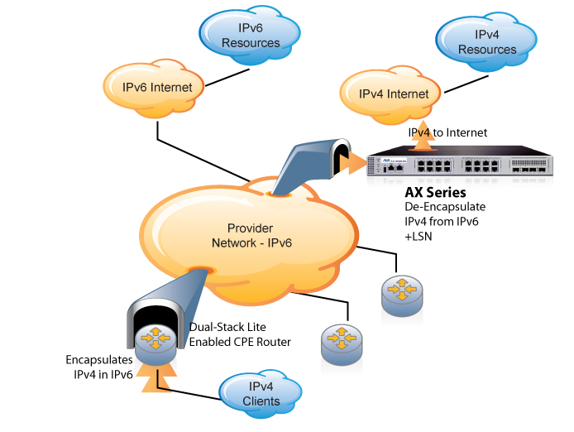
DS-Lite Solutions Allow IPv4 Clients to Connect Over the Service Provider IPv6 Network to the IPv4 Internet
Support legacy IPv4 clients on new IPv6 network

Slide 56
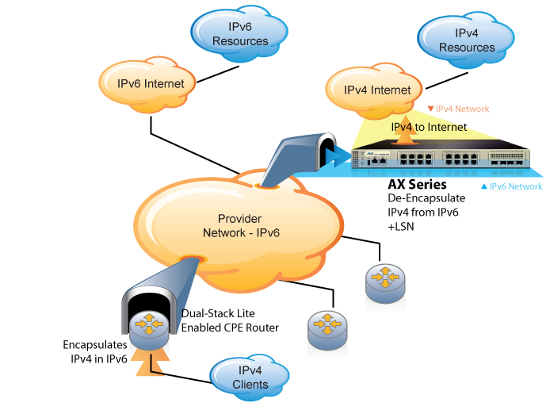
The AX Series DS-Lite Solution Enables IPv6 Deployment
The AX Series communicates with the service provider IPv6 and the IPv4 networks
Notes:
Continuation of the last slide, adds the highlight to the AX showing it is the conduit between service provider IPv6 and IPv4 networks.

Slide 57
DS-Lite features – AX DS-Lite scalability
 | # DS-Lite sessions | # New DS-Lite sessions/sec | DS-Lite pool IPs | DS-Lite Throughput
AX5200 | 64 M | 1.0 M | 10K (default 2k)¹ | 40Gbps
AX5100 | 64 M | 650K | 10K (default 2k)¹ | 40Gbps
AX3000 | 32 M | 120 K | 4K (default 500)¹ | 22Gbps
AX2600 | 16 M | 100 K | 2K (default 500)¹ | 18Gbps
AX2500 | 16 M | 85 K | 2K (default 500)¹ | 10Gbps
  DS-Lite pools/groups
    All AX platforms: 500 LSN pools (list of public IP@)
      200 LSN groups (group of individual LSN pools)
        Each LSN group can have up to 25 individual pools
Notes:
1: To change the maximum LSN public IP:
CLI: AX(config)# system resource-usage nat-pool-addr-count <num>
To see the maximum LSN public IP configuration:
CLI: AX# show system resource-usage

Slide 58
NAT64

Slide 59
Enterprise IPv6 Solution NAT64
Advantage :
  Enterprise LAN/WAN can be in full IPv6
  IPv6 makes easier the Enterprise Consolidation (Multiple private LANs concatenation)
Considerations :
  But what about IPv4 Internet Enterprise needs ?
Proposed Solution: NAT64 & DNS64

Slide 60
IETF-71 Philadelphia – 1st NAT-PT
Worked with Comcast
Double-NAT Project using 2 AX2200s
All attendees would access the v4 internet through a wireless access point
The 2 AX’s provided the IPv4-IPv6 and IPv6-IPv4 translation
Ran for the duration of the conference without any issues

Slide 61
IPv6 and DNS
IPv4
IPv6
Hostname to IP Address
A Record:
www.abc.test A 192.168.1.30
AAAA Record:
www.abc.test A AAA 2001:db8:c18:1::2
IP Address to
Hostname
PTR Record:
30.1.168.192.in-addr-arpa. PTR www.abc.test
PTR Record:
2.0.0.0.0.0.0.0.0.0.0.0.0.0.0.0.1.0.0.0.8.1.c.0.
8.b.d.0.1.0.0.2.ip6.arpa PTR www.abc.test

Slide 62
NAT64 & DNS64
IETF standard track
  draft-ietf-behave-v6v4-xlate-stateful-xx (NAT64)
  draft-ietf-behave-dns64-xx (DNS64)
NAT64 is a mechanism for translating IPv6 packets to IPv4 packets and vice-versa.
DNS64 is a mechanism for synthesizing AAAA records from A records.
The synthesis is done by adding a IPv6 prefix to the IPv4 address to create an IPv6 address.
These two mechanisms together enable client-server communication between an IPv6-only client and an IPv4-only server.

Slide 63


NAT64 & DNS64 Topology
AAAA www.example.com = Error
AAAA Query
www.example.com
A www.example.com = 192.2.0.33
AAAA Response: 2001:DB8:122:344::192:0:2:33
DNS64
IPv4 Internet
IPv6 Network
IPv6 Clients
www.example.com
192.2.0.33
NAT64
DNS64 owns IPv6 Prefix 2001:DB8:122:344:::/96

Slide 64
NAT64 & DNS64 Topology
DNS64
IPv6 Clients
IPv4 Internet
www.example.com
192.2.0.33
SIP: 2002:ACE:888:007::101:1024
DIP 2001:DB8:122:344::192:0:2:33:80
NAT64
SIP: 204.16.75.101:1024
DIP : 192.0.2.33:80
NAT64 owns IPv4 Address Pool 204.16.75.0/24

Slide 65
Features of NAT64 and DNS64
Supports peer-to-peer communication between IPv4 and IPv6 nodes, including the ability for IPv4 nodes to initiate communication with IPv6 nodes.
End Point Independent Mapping and Filtering
Full Cone NAT
Support for DNSSEC (Roadmap)
Support for IPSec (Roadmap)

Slide 66
Summary

Slide 67
Summary
A10 has the most suitable, cost effective platform to deploy NAT and IPv6 Solutions
A10 has carrier capable IPv6 and NAT solutions for deployment into carrier networks TODAY
Evaluations and Demonstrations have been under way since 2007
Development of IPv6 and NAT solutions have been carried out in conjunction with Carrier customers using real requirements.
We continue to develop new features and deploy them rapidly

Slide 68
Q&A
Stefaan Eens
Channel Manager EMEA
seens@a10networks.com
+32 478 25 90 16
Mischa PETERS
SE Northern EMEA
mpeters@a10networks.com
+31 6 2181 8161
Manuel MARTINEZ
Presenter
mmartinez@a10networks.com

Slide 69
AX Series
Deployement modes

Slide 70






Deployment Considerations
64.x.x.x
192.168.x.x
192.168.x.x
192.168.x.x
Router
Load Balancer
Servers
Router
Load Balancer
Servers
1. Routed Mode
The Modes of
Server Load
Balancing
3. Transparent Mode
2. One-Arm Mode
4. DSR Mode
Load Balancer
Load Balancer
192.168.x.x
192.168.x.x
192.168.x.x
192.168.x.x
Router
Servers
Router
Servers

